Slide 1
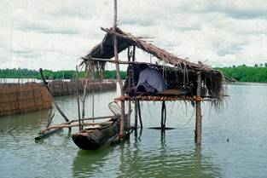
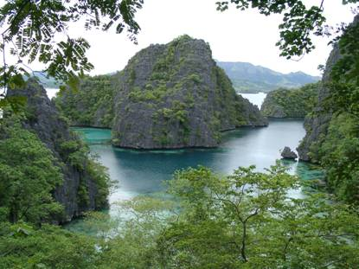
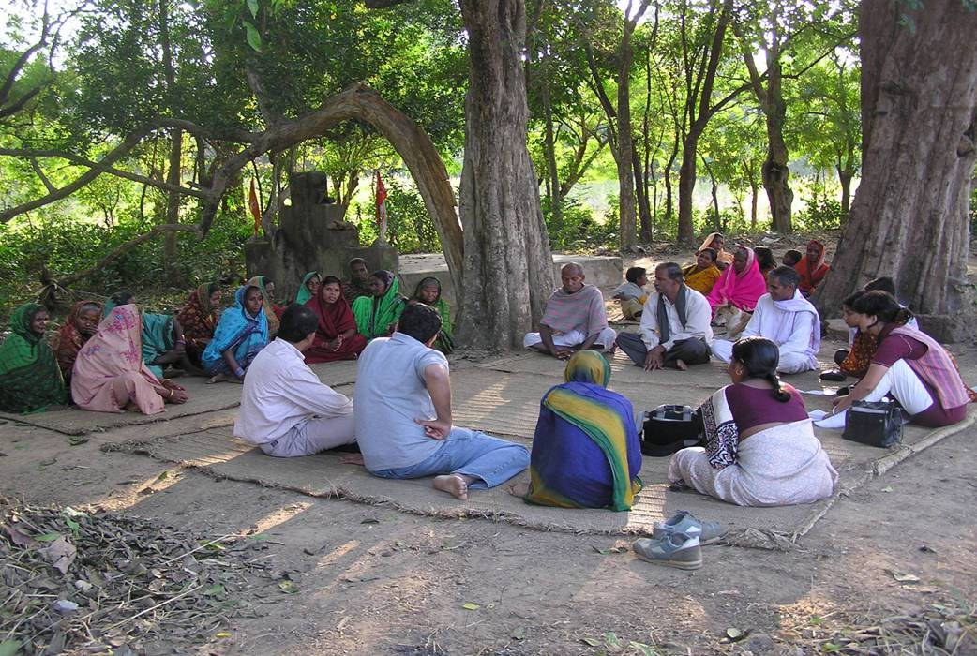
Indigenous Peoples and Local Communities’ Conserved Territories and Areas (ICCAs)
Ashish Kothari
Kalpavriksh and ICCA Consortium

Slide 2
Through millennia, the main decision makers and “managers” about natural resources have been human communities (gatherers, hunters, herders, peasants, fisherfolk, forest users …)
Cultural diversity and biological diversity evolved together ... have not been considered separate … humans as part of nature
Notes:
stan

Slide 3
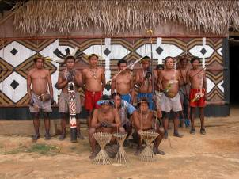
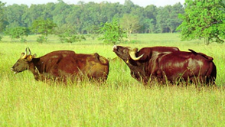
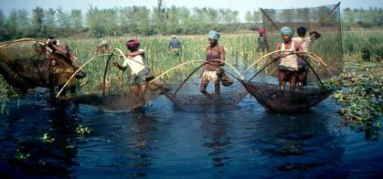
customary practices that fostered conservation (including sustainable use)
access/use rules & limitations
sacred, forbidden, “reserved” spaces
species-specific interdictions (taboo)
based on:
local knowledge, understanding of relations between natural resources and community livelihoods
historical experience of changes
cultural values (worldviews, spiritual and religious beliefs, social privileges…)
and regulated by:
customary institutions
capacity for sanctions within and between communities
voluntary mutual obligations within and between communities
Notes:
stan

Slide 4
…but global changes through last few centuries, especially last two, & accelerating in last few decades
“Enclosure of the commons”, private property
Agro-industrial and industrial revolutions
Colonisation, and development of nation states
Capitalist expansion, economic globalisation
All of above building on patriarchy
State & corporations replacing communities in governance & control of nature
Notes:
gbf

Slide 5
Traditional systems | Agro-industrial-market system
Tenure and use of natural resources based on communal property regimes, regulated by customary laws | Tenure and use of natural resources based on private and state property regimes, regulated by written law
Supported by the social organisation of communities and by forms of reciprocities with other communities | Promoted by the state and private businesses and backed by military power
Local, relatively small-scale, with many context-depending features | Supra-national/ international; global, large-scale, similar everywhere
Focus on community livelihoods | Focus on the generation of private, corporate or state wealth
Mostly subsistence-oriented | Mostly market-oriented
Traditional technologies, tested at the local level, in the relevant area, for a long time | Innovative technologies, often recently tested only outside the area of application, in different social and environmental settings
Based on the control of land, biological resources and water. | Based on the control of energy sources (e.g. oil), mineral sources and water.
Based on soft inputs and small capital investment, including for transportation | Requires sophisticated inputs and major capital investments, including for transportation
Notes:
stan

Slide 6
Traditional systems | Agro-industrial-market system
Decisions are taken by tightly knit social organisations, closely interacting with society and acting in the local sphere | Decisions are taken by economically-tied individuals, corporate staff & state decision-makers, dispersed and acting on a global scale
Politically and economically weak on the large scale | Politically and economically powerful on the large scale
Mostly implicit, i.e., working on the basis of feedback from other cultural elements | Mostly explicit, i.e., based on intentional strategies
Based on local knowledge and skills, the recognition of indeterminacies, risk-aversion behaviour and an emphasis on experimentation and adaptation | Based on “objective science”, aiming at the reduction of subjective, local decisions and uncertainties
Aims at long-term sustainable livelihood (defined in a rather general sense) | Aims at relatively short-term, precisely measurable results
Important religious and symbolic value attached to nature | Little religious or symbolic value attached to nature
Conservation through use and limitations | Strict separation between exploitation and protection
Conservation mostly understood as sustainable production to sustain livelihoods & habitats, or cultural importance | Conservation as preservation of biodiversity and maintenance of ecosystems for recreational, aesthetic, scientific & economic purposes
Notes:
stan

Slide 7
Traditional systems | Agro-industrial-market system
Pervasive social differentiation and hierarchies (gender, class, caste, religious) often leading to inequities and exploitation | Explicit emphasis on social equality/ egalitarianism and equity (in theory)
Could be feudal/ royal/ elite-dominated, and religion is often directly connected with political power | Generally in favour of democratic governments (although still elite-dominated); religion nominally separated from political power
Important knowledge gaps regarding biodiversity (e.g. micro-organisms), but generally holistic ways of knowing | Knowledge pushed to explore all dimensions of biodiversity through innovative methods and techniques, but limited to ‘rational’ ways of knowing
Generally not oriented towards active restoration (different from regeneration) | Restoration as major scientific endeavour
…. | ….
Notes:
7
stan

Slide 8
This change has been paralleled by other socio-economic and ecological phenomena.
Economic development has greatly increased the production and consumption of goods by part of humanity
Population dynamics: growth, migration, urbanization…
Communication, networking, exchanges among peoples and cultures have increased exponentially…
Inequalities (especially in economic terms) have enormously increased
Significant biodiversity loss, pollution, climate crisis …
Notes:
stan

Slide 9
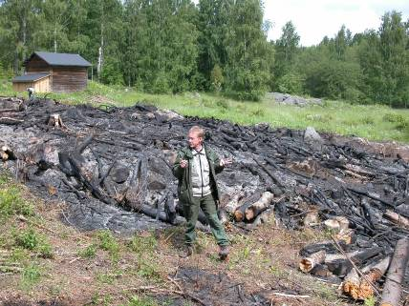
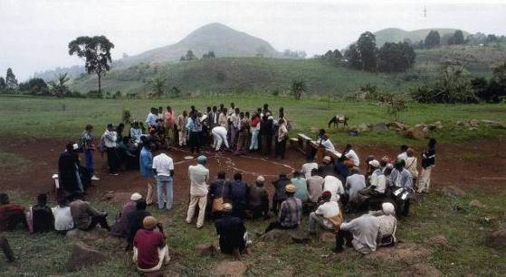
However…
The “historical shift” from traditional management systems to global agro-industrial market system is very incomplete and will likely will never be complete!
In many countries— especially in the South, but also in the North—some sort of interface between the two systems
So, a major opportunity for transformation towards best of both worlds …
Notes:
stan

Slide 10
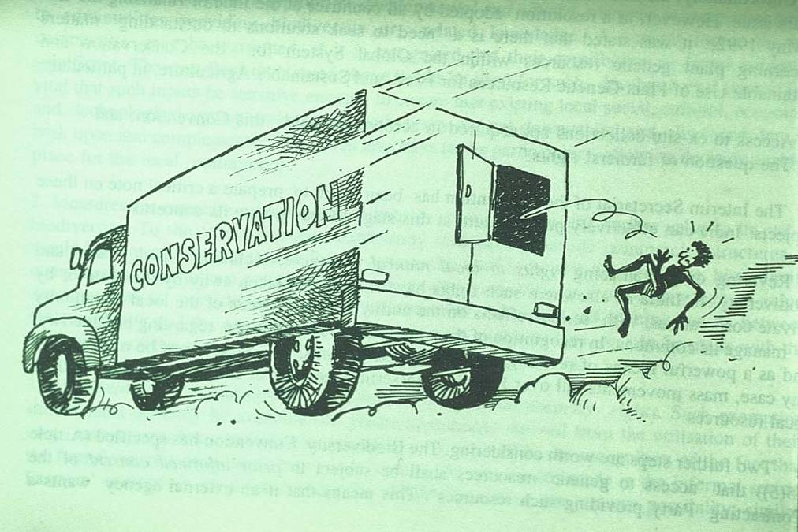
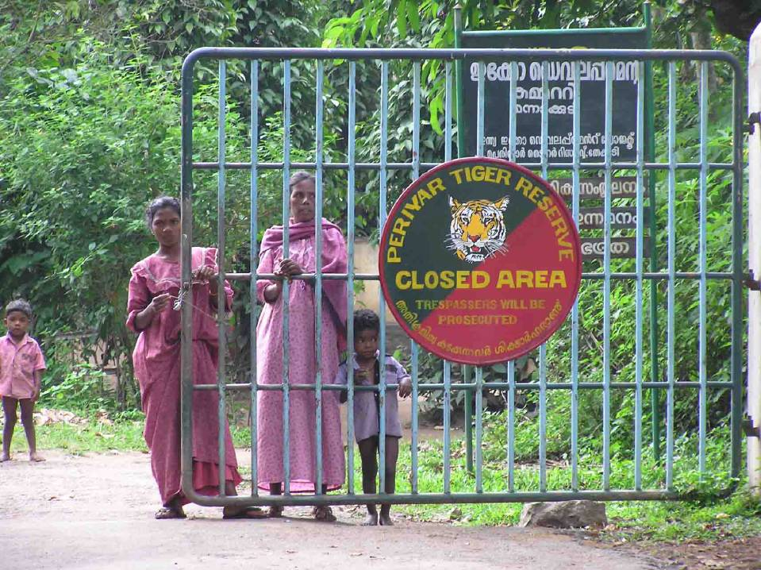
Shifts in official conservation policy
Conventional ‘Yellowstone’ model since 1900s
Conservation for scientific / aesthetic purposes, not for use
separation of nature and people: displacement and dispossession (several million people?)
management by trained, centralised bureaucracy: community governance institutions disempowered
emphasis on formal, modern expertise, displacement of local knowledge
But increasing realisation that this is unjust and ineffective

Slide 11
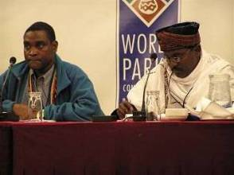
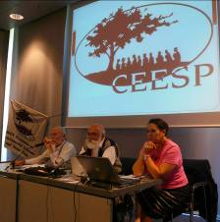
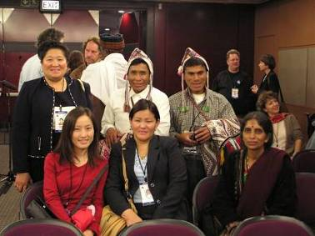
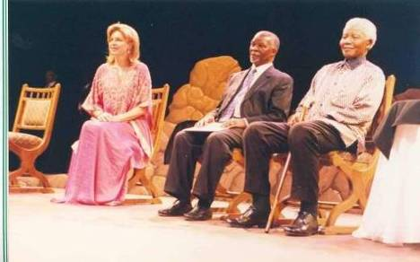
Beginnings of paradigm shifts: 2003 – 5th World Parks Congress (Durban, South Africa) 2004 – Convention on Biological Diversity: Programme of Work on Protected Areas (Kuala Lumpur, Malaysia) Big shift: from ‘management’ to ‘governance’
Notes:
Prabhu

Slide 12
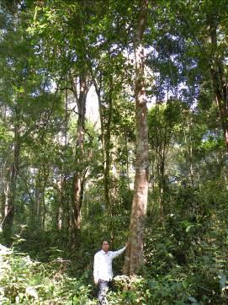
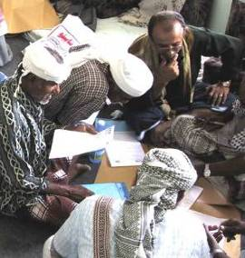
management
How to achieve specific aims:
strategies, actions, means (human, technical, financial…)
monitoring of results
Assessment: are desired results being achieved? (management effectiveness)
governance
Who takes decisions?
power, authority and responsibility
relations among actors: participation, equity, transparency, vision, accountability
Assessment: are indicators of just, good governance being met? (governance assessment)
Notes:
12

Slide 13
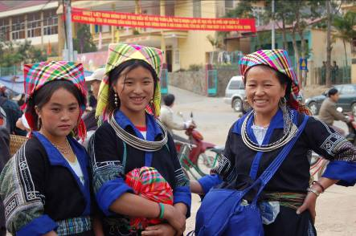
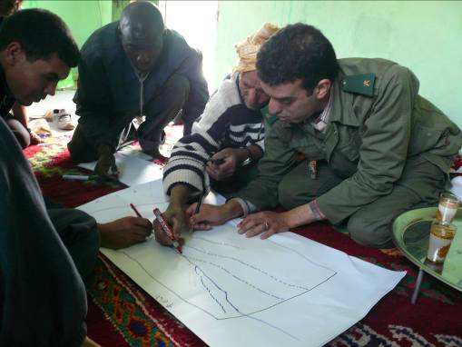
What is “innovative” about governance of conservation in new paradigms?
quality
type
Notes:
13
gbf

Slide 14
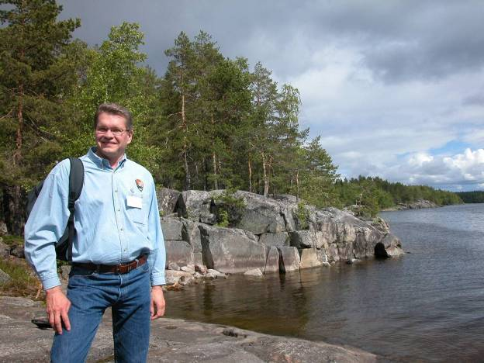
Quality: principles of “good governance” related to the work of UN agencies and highlighted at the Vth World Parks Congress and beyond
Legitimacy and Voice
Transparency
Accountability
Equity/ Fairness
Vision/ Direction
Respect of human rights
Notes:
14
gbf

Slide 15
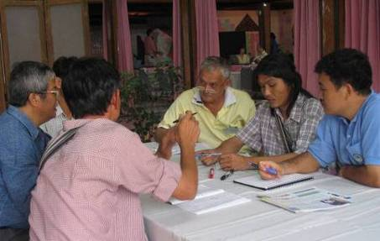
Type …
…who holds PA management authority and responsibility and is held accountable for decisions about a given conserved area?
4 main “governance types” have been distinguished on the basis of the answer:
A. the government (and its agencies at various levels)
B. various parties (together)
C. the owners of the concerned land and natural resources (individuals, NGOs, corporate bodies…)
D. the concerned indigenous peoples and local communities
all types are legitimate and important for conservation!
Notes:
15
gbf

Slide 16
IUCN matrix of protected areas categories and governance types (2008 Guidelines)
Governance type Category (mngmt. objective) | A. Governance by Government |  |  | B. Shared Governance |  |  | C. Private Governance |  |  | D. Indigenous Peoples & Community Governance
 | Federal or national ministry or agency | Local/ municipal ministry or agency in change | Government-delegated management (e.g. to an NGO) | Trans-boundary management | Collaborative management (various forms of pluralist influence) | Joint management (pluralist management board) | Declared and run by individual land-owner | …by non-profit organisations (e.g. NGOs, univ. etc.) | …by for profit organisations (e.g. corporate land-owners ) | Indigenous bio-cultural areas & Territories- declared and run by Indigenous Peoples | Community Conserved Areas - declared and run by traditional peoples and local communities
I - Strict Nature Reserve/ Wilderness Area
II – National Park (ecosystem protection; protection of cultural values)
III – Natural Monument
IV – Habitat/ Species Management
V – Protected Landscape/ Seascape
VI – Managed Resource
Notes:
16

Slide 17
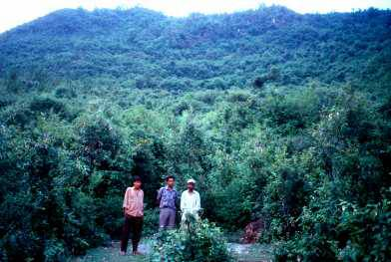
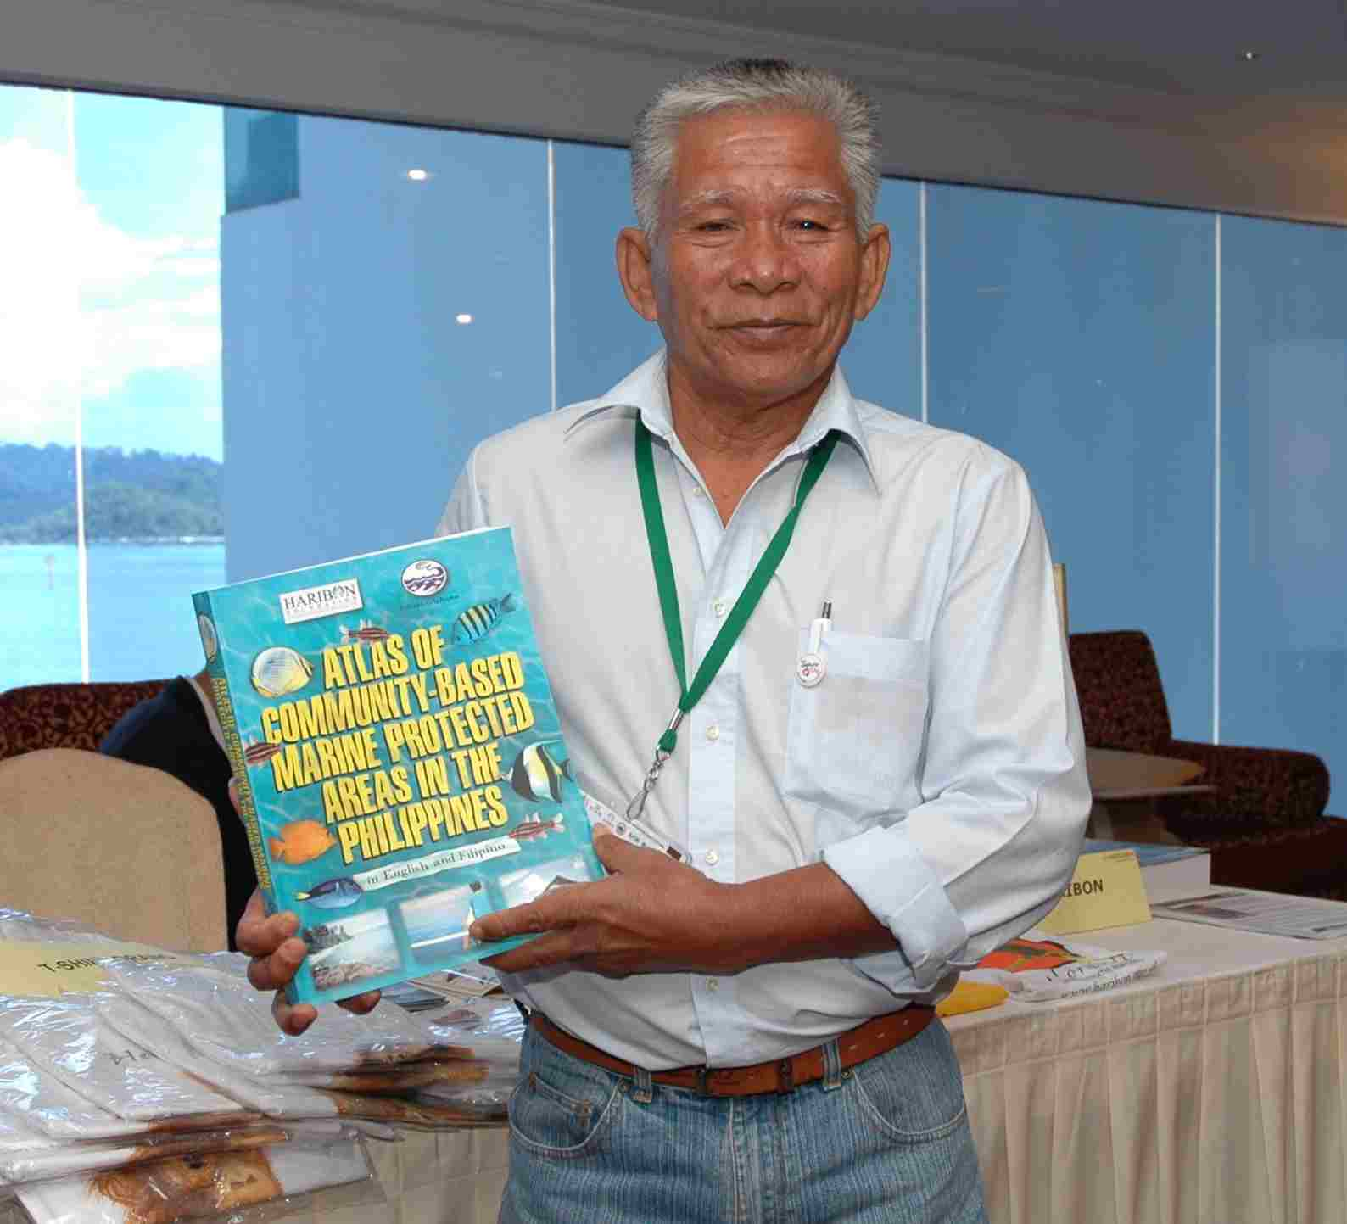
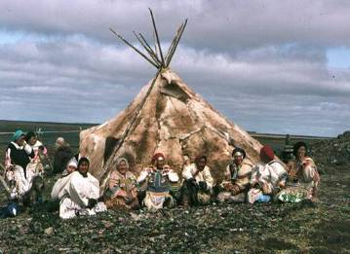
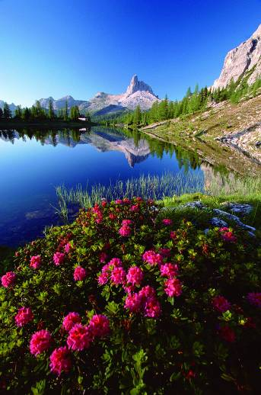
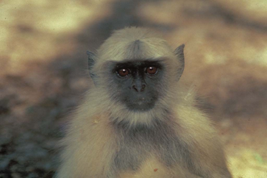
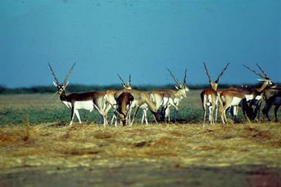
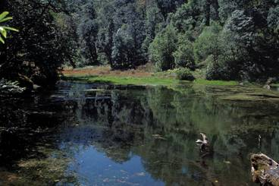
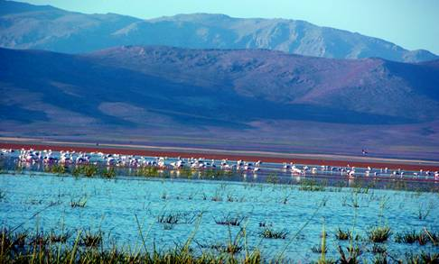
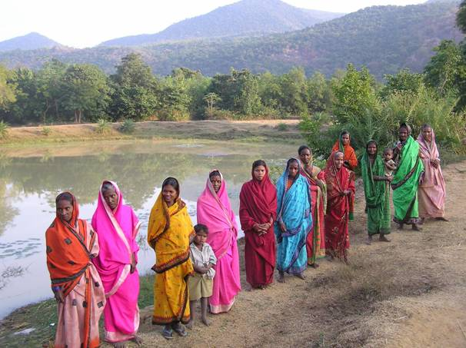
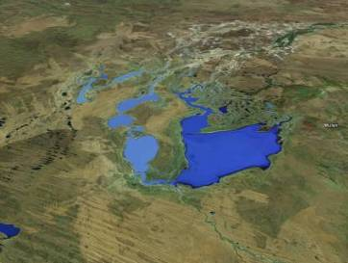
Indigenous peoples and local community conserved territories and areas (ICCAs)
natural and modified ecosystems
with significant biodiversity, ecological functions and cultural values
voluntarily conserved by indigenous peoples and local communities
through customary laws or other effective means

Slide 18
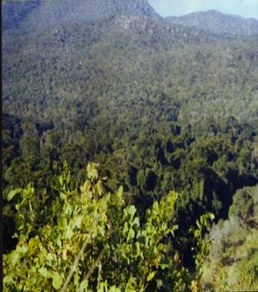
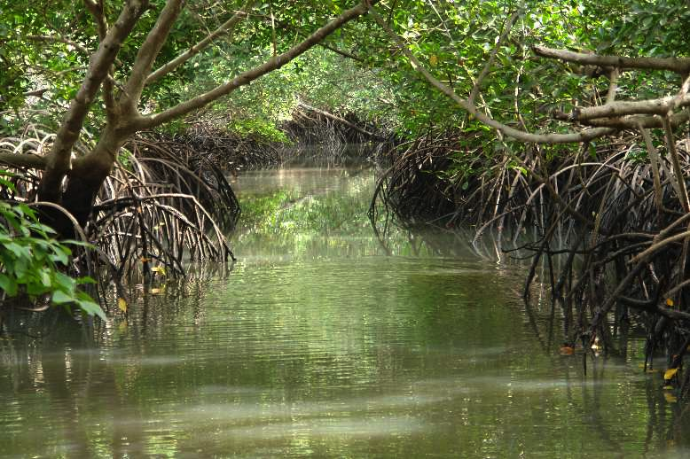
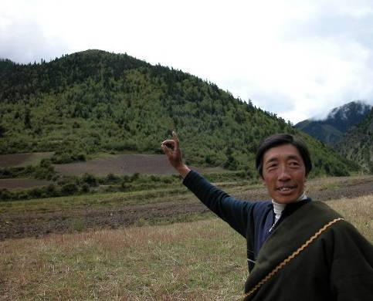
Global diversity of ICCAs...
sacred natural sites…
Sacred bolon in Kawawana, Senegal
© Christian Chatelain
Chizire sacred forest,
Zimbabwe
Sacred hill tops, Tibet, China © Grazia Borrini-Feyerabend
Sacred lake, Indian Himalaya © Pankaj Sekhsaria
Notes:
18
18
gbf

Slide 19
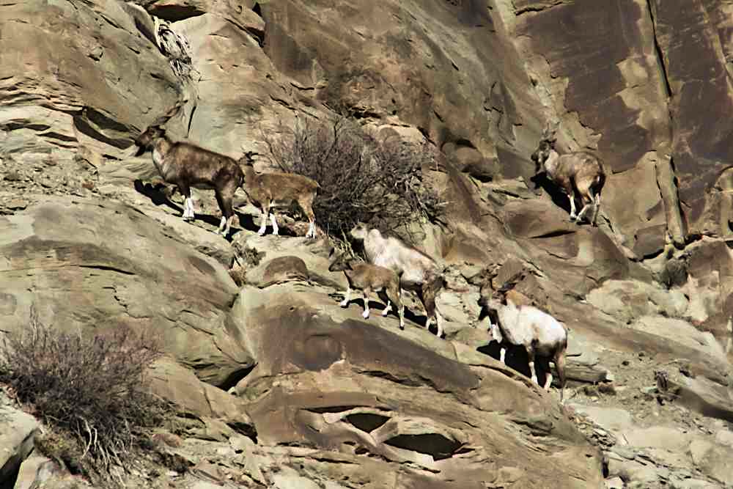
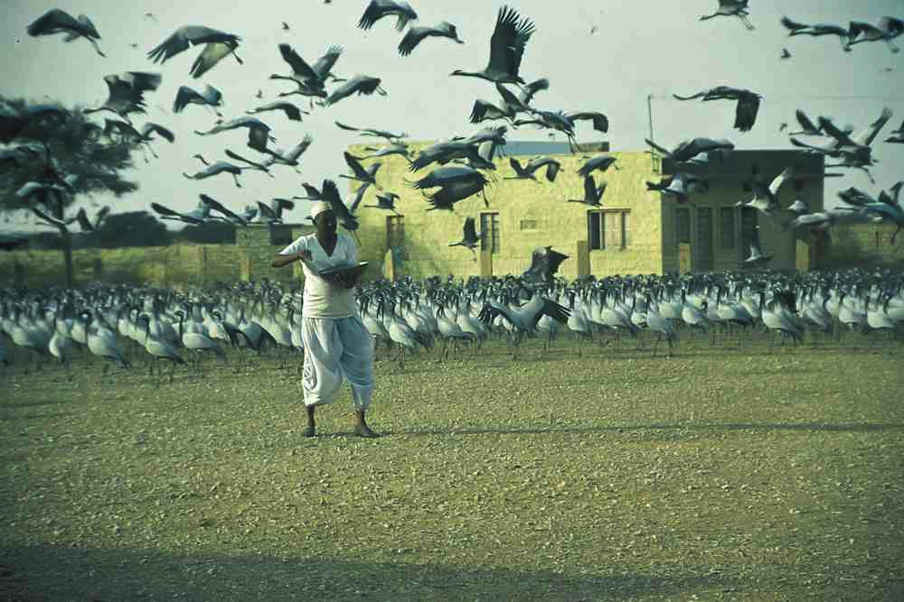
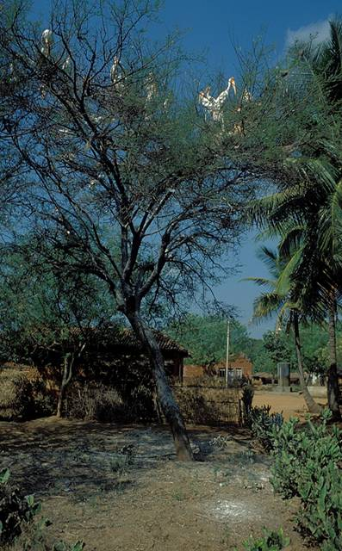
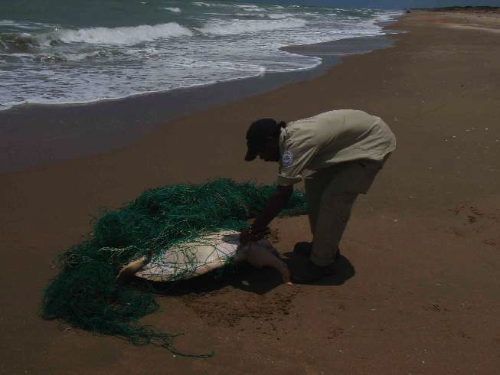
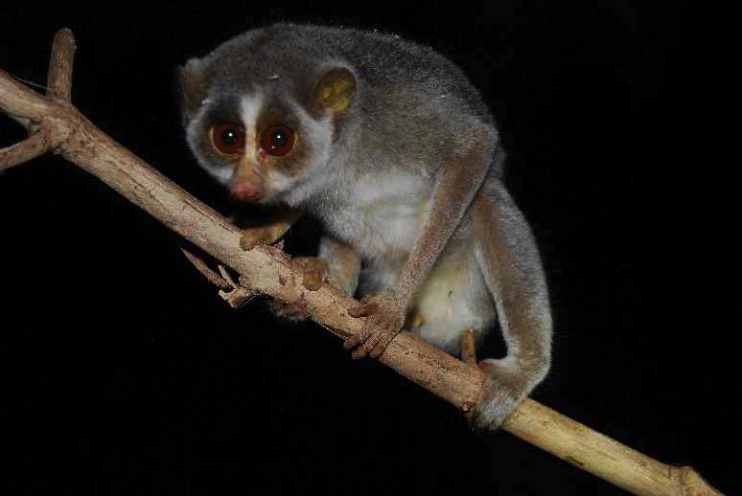
Global diversity of ICCAs…
Wildlife populations
nesting, roosting, feeding habitats
Community-protected Markhor at Torgarh, Pakistan © Tahir Rasheed
Demoiselle cranes, Kheechan village, India © Asad Rahmani
Slender loris, Nagavali villages, India © Ashish Kothari
Indigenous ranger at Mapoon rescuing sea turtle, Australia © Craig Wheeler
Traditional heronry, Kokare Bellure, India © Ashish Kothari

Slide 20
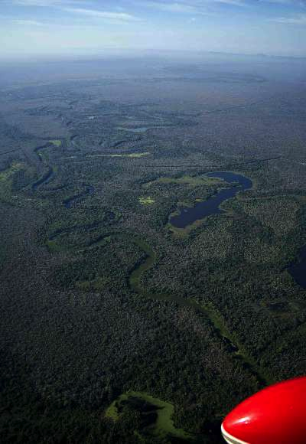
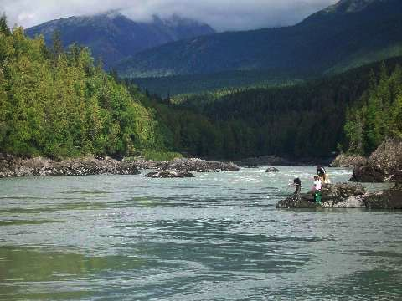
Global diversity of ICCAs...
indigenous territories and cultural landscapes/seascapes…
Skeena River in Gixtsan territory, Canada © Francois Depey
TCO Isoso, Bolivia © Carmen E. Miranda L.
Mandingalbay Yidinji IPA, Australia © Cairns Post
Notes:
20
20
gbf

Slide 21
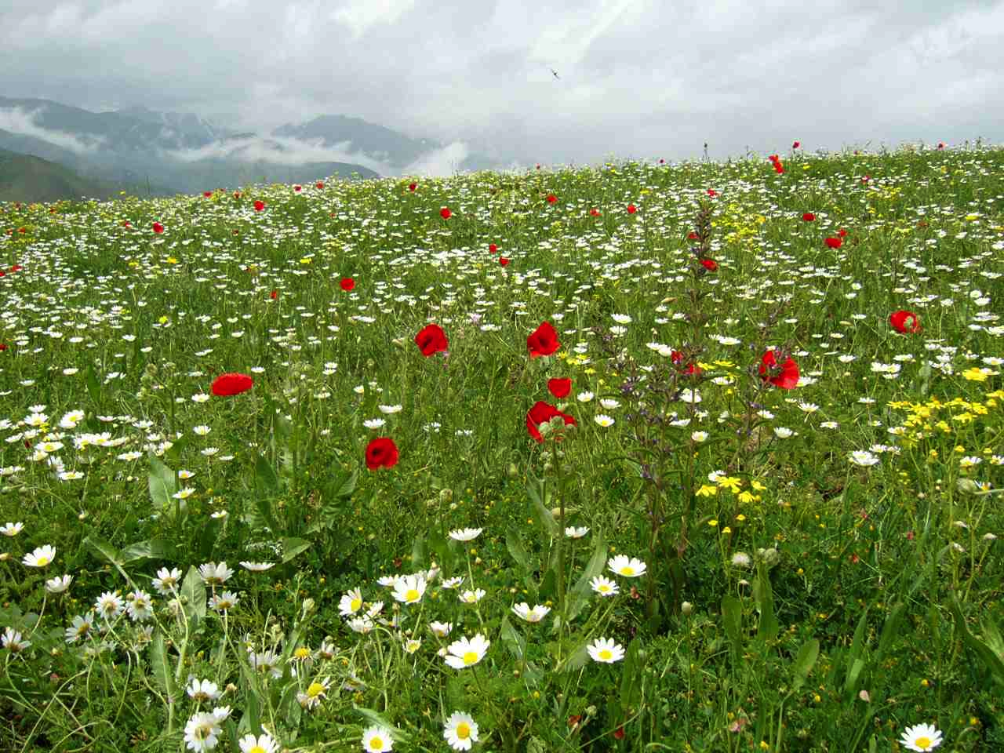
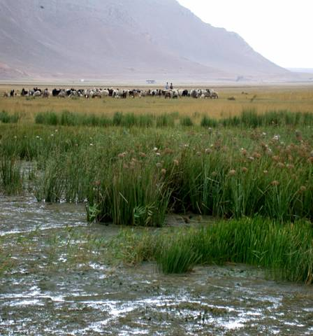
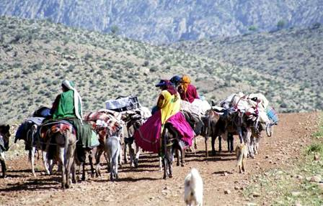
Global diversity of ICCAs...
territories & migration routes of nomadic herders / mobile indigenous peoples…
Shahsavan peoples’ territory, Iran
Courtesy CENESTA
Wetlands in Qashqai mobile peoples’ territory, Iran
Notes:
21
21
gbf

Slide 22
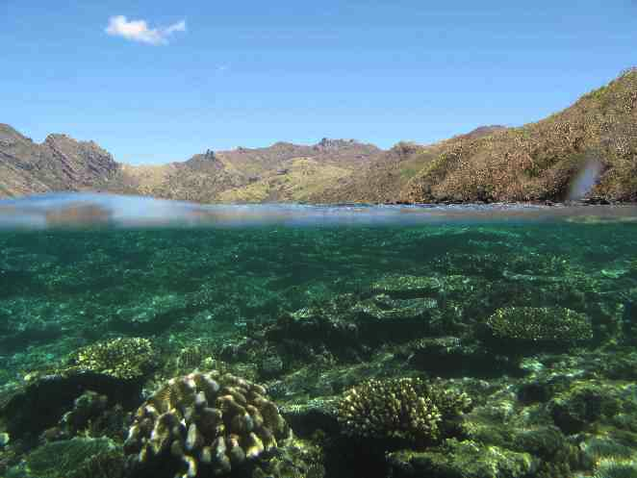
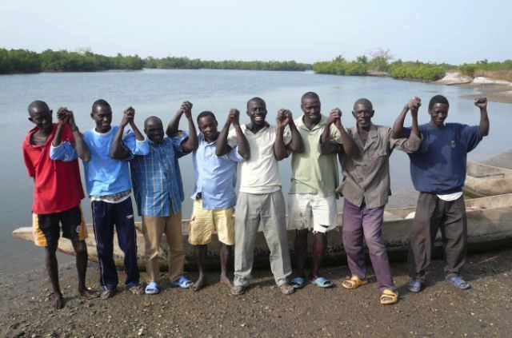
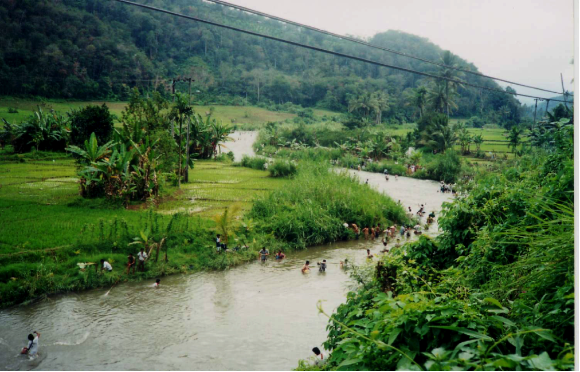
Global diversity of ICCAs…
sustainably-managed wetlands,
coastal and marine areas…
Waya Island, Fiji (one of many Locally Managed Marine Areas) © Stacy Jupiter
Kawawana ICCA, Senegal
Coron Island, Tagbanwa Ancestral Domain, Philippines © Ashish Kothari
Lubuk Larangan river, Mandailing, Sumatra
Notes:
22
22
gbf

Slide 23
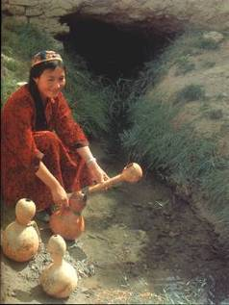
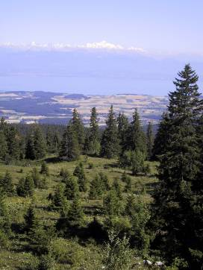
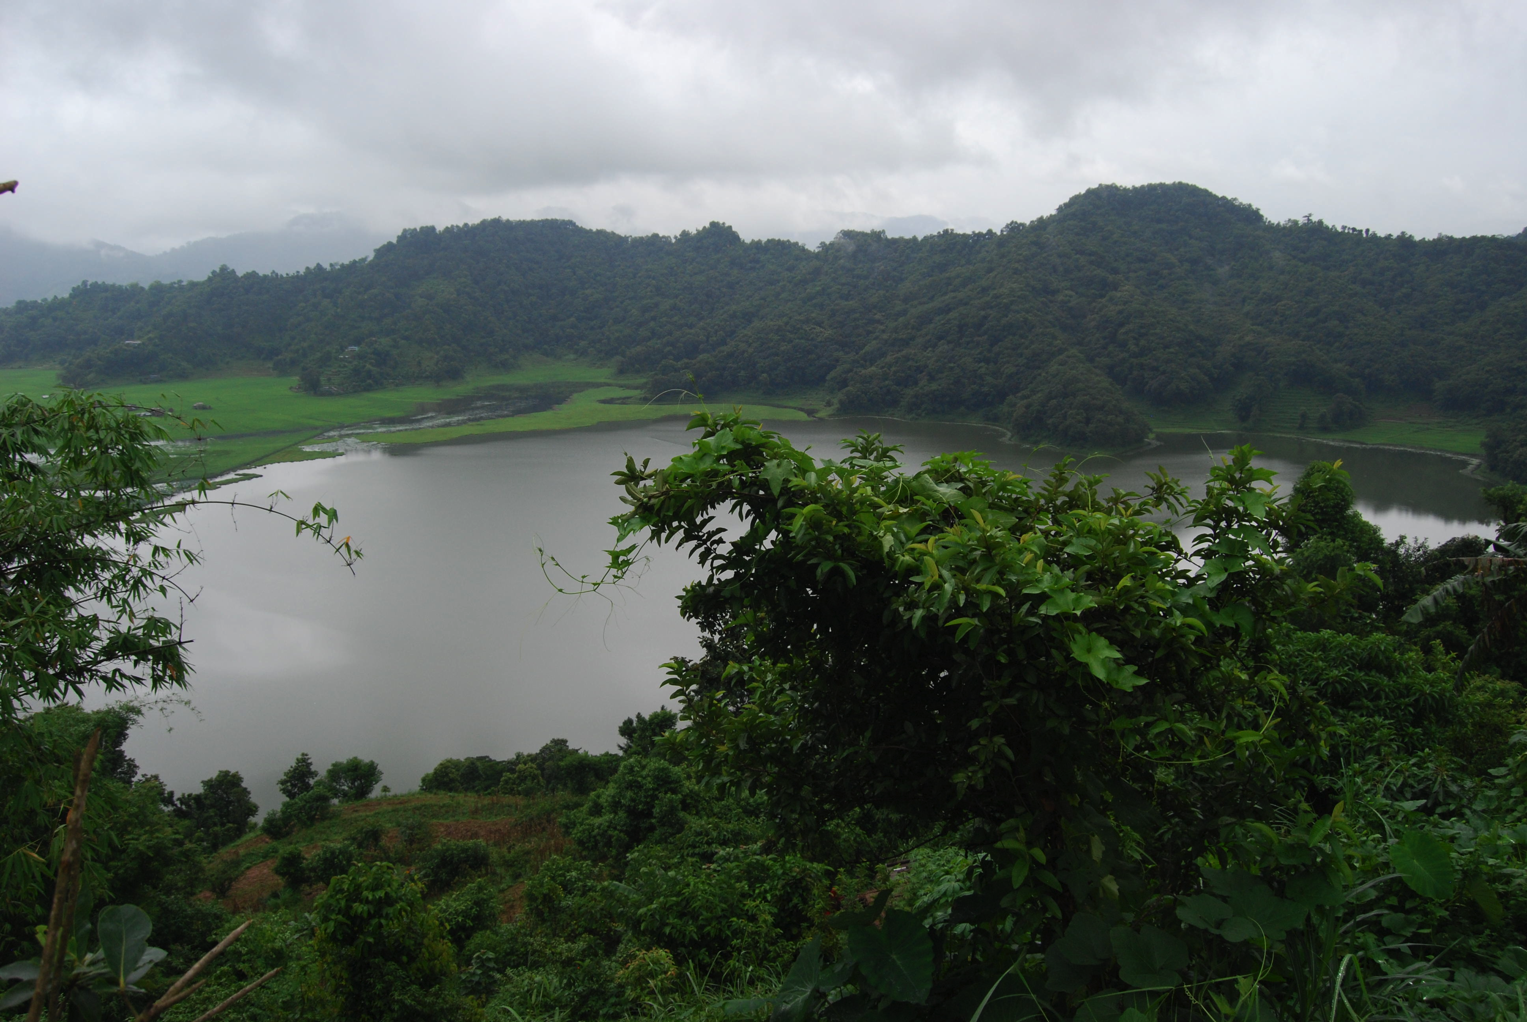
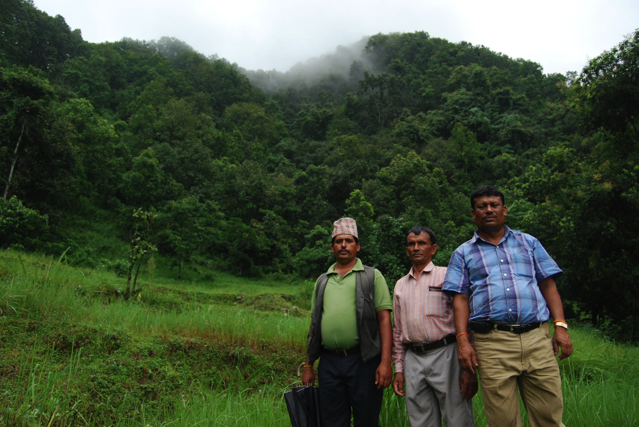
Global diversity of ICCAs….
sustainably-managed resource reserves (biomass, medicinal plants, timber and non-timber forest products…)
Qanats, Central Asia
Parc Jurassien Vaudois, Switzerland
Himalayan forest, Jardhargaon, India © Ashish Kothari
Community forests and lake, Rupataal, Nepal © Ashish Kothari
Notes:
23
23
gbf

Slide 24
Three defining features of ICCAs
(not all indigenous/community lands are ICCAs!)
Predominant decisions by community (regardless of land or resource ownership)
Community has rules or institutions for governance and management
Community management is achieving conservation (regardless of objectives)

Slide 25
Extent of ICCAs?
No comprehensive estimate available
Some examples:
Worldwide: 500 million ha of forests (15% of the world’s total) under community ownership / management (2011); of this, about 90% under some level of conservation management (Rights & Resources Institute).
Brazil: 1/5th of Amazon under indigenous reserves (5X govt PAs, and achieving equal or better conservation; Nepstad et al 2006)
Philippines - over 60% of forests in indigenous territories; 4.5 m.ha. recognised as Ancestral Domain (Pedgragosa 2012)
Australia: 25% of protected area estate are Indigenous PAs (Govan/Grant 2012)
Namibia: 14 m.ha. community forests & conservancies (Jones 2012)
Fiji: 1.7 m.ha. under Locally Managed Marine Areas (100% of marine PAs; Govan 2012)
Mexico (Oaxaca): 82% forests community owned/managed (Martin et al 2010)
South Asia: Thousands of unrecognised ICCAs (no estimate)

Slide 26
ICCAs could double the earth’s coverage of protected areas and other effective area-based conservation sites!
Chilika Lagoon
B a y o f
B e n g a l
address gaps in the system
improve connectivity in the landscape, and flexibility and resilience of the system
help adapt to climate change
Notes:
26
prabhu

Slide 27
What is the worldwide significance of ICCAs?
Maintain critical ecosystem services and provide ecological connectivity and resilience
Are the basis of livelihoods and cultural identity for millions of people
Are site-specific, adaptive, and built on sophisticated ecological knowledge systems
Shimshal Community Conserved Area, Pakistan
Walalkara Indigenous PA, Australia
Suva youth in traditional attire, Fiji © Stacy Jupiter

Slide 28
ICCAs also link ‘wild’ and ‘domesticated’ biodiversity, and associated cultures…providing resilience, adaptation, food sovereignty

Slide 29
ICCAs provide aesthetic & community cohesion opportunities
Forests of Wet'suwet'en First Nation territory © Francois Depey
Bredhurst Wood volunteers, UK © Vanessa Jones

Slide 30
Strategic Plan for Biodiversity 2011-20 (Aichi Targets) adopted by CBD parties in 2010
By 2020, at least 17 per cent of terrestrial and inland water, and 10 per cent of coastal and marine areas, especially areas of particular importance for biodiversity and ecosystem services, are conserved through effectively and equitably managed, ecologically representative and well connected systems of protected areas and other effective area-based conservation measures, and integrated into the wider landscapes and seascapes.

Slide 32
threats & challenges
‘Development’: mining & oil extraction, logging, industrial fisheris/agriculture/livestock breeding/plantations, dams, urbanisation, major infrastructure
Grabbing of community land (nationalisation, privatisation, state-governed protected areas…)
Forced / induced cultural change (formal education, evangelisation, publicity …)
War, conflicts and movement of refugees
Excessive taxes, fees
Divisions created by political parties / interests
Air and water pollution; invasive species; climate change
Inappropriate recognition by governments

Slide 33
threats & challenges (contd.)
Internal inequities: class, gender, caste, ethnicity, age …
Demographic changes: migration, population increase …
Weakening of nature-livelihood-culture links, new aspirations of a ‘good life’
Inappropriate recognition and support by governments, civil society …

Slide 34
CBD Programme of Work on PAs (PoWPA) commits countries to:
National PA system reviews, to include innovative governance types: including indigenous and community conserved areas (ICCAs)
Promote legal recognition of full set of governance types (incl. ICCAs)

Slide 35
How are countries faring in recognising and supporting ICCAs?

Slide 36
Study by ICCA Consortium coordinated by Kalpavriksh Published by CBD Secretariat
Supported by:
The Christensen Fund
UNDP (Norway)
European Union
Other partners
Natural Justice
GEF Small Grants Programme
IUCN TILCEPA

Slide 37
Country case studies
Global overview & analysis

Slide 38
Three ways to legally recognise ICCAs (distinct or overlapping)
As part of protected area system (e.g. in PA law)
As part of more general conservation measures (e.g. in biodiversity law)
Embedded in recognition of indigenous peoples, decentralised governance, etc (e.g. in land reforms law)

Slide 39
Progress of legal recognition
Forests under community ownership/management, up from 10 to 15% in last decade (RRI 2012)
Brazil, Bolivia, Columbia, Australia: indigenous territories designated in ~200 hundred m.ha.
Philippines: Ancestral Domain titles to many indigenous territories, could go up to 6-7 m.ha.
India: Community Forest Rights (incl. use/management) to ~ 0.5 m.ha. (slowly increasing..potential is >30 m.ha.)
Kenya, Namibia, Tanzania: community forests &/or conservancies, full management and use control, several m.ha.
Fiji: recognition of Locally Managed Marine Areas (100% of country’s marine protected area system)
Iran: much of country under mobile peoples’ territories, with increasing recognition

Slide 40
Challenges of legal recognition
Imposition of uniform or inappropriate prescriptions
Grafting ‘jointness’ or govt role onto community governance
Contradictory / non-harmonised laws and policies (e.g. mining vs. indigenous rights; conventional conservation vs. ICCAs)

Slide 41
Non-legal recognition and support (by govts / civil society)
Documentation & databases (Australia, Fiji, India, Namibia...)
Social recognition (Kenya, Chile, Philippines, UK … India award at COP11)
Administrative/technical/financial (Iran SGP, Canada land claims, Senegal eco-guards)
Advocacy/networking by IPs/LCs/civil society (Philippines, Nepal, Madagascar, Suriname)

Slide 42
Challenges of non-legal recognition and support
Top-down / non-participatory documentation
Imposition of inappropriate models in capacity / training programmes
Inappropriate kinds/levels of funding
Commodification/commercialisation approaches
Unwelcome attention

Slide 43
Strategic Plan for Biodiversity 2011-20 (Aichi Targets) adopted by CBD parties in 2010
By 2020, at least 17 per cent of terrestrial and inland water, and 10 per cent of coastal and marine areas, especially areas of particular importance for biodiversity and ecosystem services, are conserved through effectively and equitably managed, ecologically representative and well connected systems of protected areas and other effective area-based conservation measures, and integrated into the wider landscapes and seascapes.

Slide 44
New kid on the block: Other Effective Area-Based Conservation Measures (OECMs)
Areas that are effectively conserved but not part of the official protected area system
OECMs are “clearly defined geographical space where de facto conservation of nature and associated ecosystem services and cultural values is achieved and expected to be maintained in the long-term regardless of specific recognition and dedication” (Borrini-Feyerabend & Hill 2015)
^{Need to clarify:}
^{‘Effective’?}
^{‘Area-based’?}
^{‘Conservation’?}
^{‘Measures’?}

Slide 45
Guidance on OECMs
IUCN Working Group

Slide 46
ICCA timeline
3000 (?) years before present (BP) to now: sacred sites/species, other conserved sites (many surviving, many lost)
1990s: documentation of sites in several countries
1998: Task Force on PAs and people as part of World Commission on Protected Areas
1999: use of term ‘CCAs’ for Indian sites
2000: IUCN Theme group on PAs/people (TILCEPA) established -- discussion on CCAs as “new category” of protected areas
2000-02: start of networking on CCAs
2003: resolutions on governance of protected areas, on mobile indigenous peoples and on CCAs at the Vth World Parks Congress
2003: first governance /management matrix; CCAs as a new governance type

Slide 47
ICCA timeline (contd)
2004: integration into PA Programme of Work (Biodiversity Convention)
2004-now: series of regional/national studies and consultations by several organisations
2004/2008: consolidation at World Conservation Congresses and new and more complete IUCN Resolutions
2004-onwards: new laws/policies/practices relating to CCAs in several countries (e.g. Madagascar, India, Bolivia); CCAs established as priority for funding by UNDP
2007: UN Declaration on the Rights of Indigenous Peoples

Slide 48
ICCA timeline (contd)
2008: change from CCA to ICCA, incorporation of ICCAs into new IUCN PA Category Guidelines
2008-on: ICCA Consortium established; significant increase in studies and publications, dedicated website
2010-on: ICCAs included in each CBD meeting, increasing presence in other forums (climate, indigenous rights, forests)

Slide 49
…2025: ICCAs that are officially and appropriately recognised and supported cover 10-15% of terrestrial and marine ecosystems (and unrecognized, much more?); ICCAs are much more secure and keep providing conservation, livelihoods and cultural benefits to peoples and the planet ?

Slide 50
What is needed?
Documentation and articulation of values
Territorial and resource rights
Institutions of collective governance
Right to exclude destructive activities (e.g. mining)
Respect of diverse lifestyles, cultures, economies, institutions
Recognition as conservation units (PAs, ‘other effective area based measures’, or other forms)
Support for advocacy and networking

Slide 51
for more information:
www.iccaconsortium.org
chikikothari@gmail.com

