Slide 1
“Defending Territories of Life & Their Defenders”
ICCA Consortium General Assembly
December 2019: Pooven Moodley,
José Aylwin, Holly Jonas

Slide 2
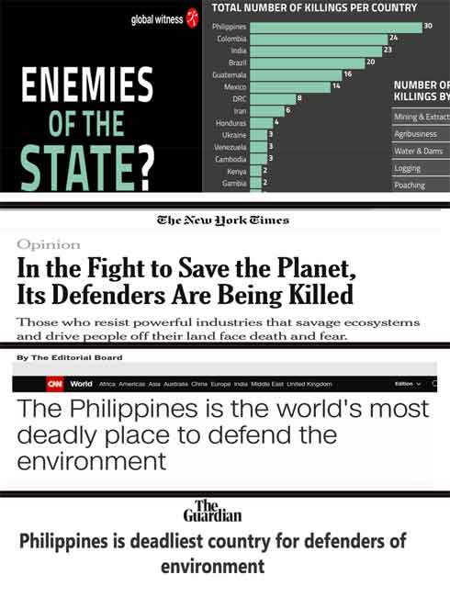

Slide 3
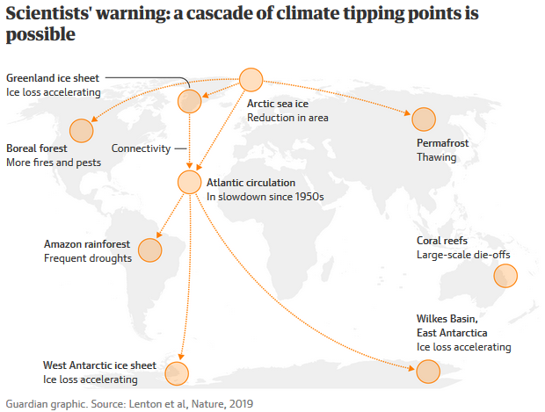

Slide 4
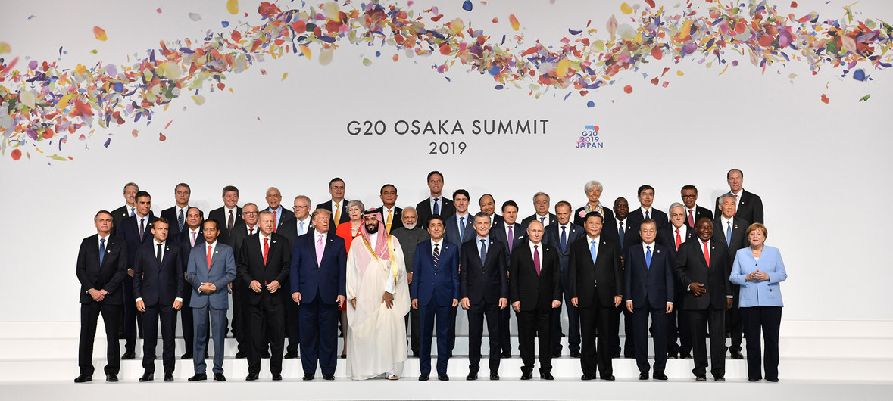

Slide 5
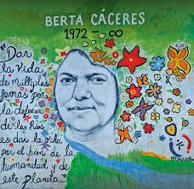

Slide 6
© Getty Images
Notes:
Indigenous peoples and local communities are on the frontlines of struggles to resist these threats … they are both the first and the last lines of defense to protect and defend their territories and areas.

Slide 7
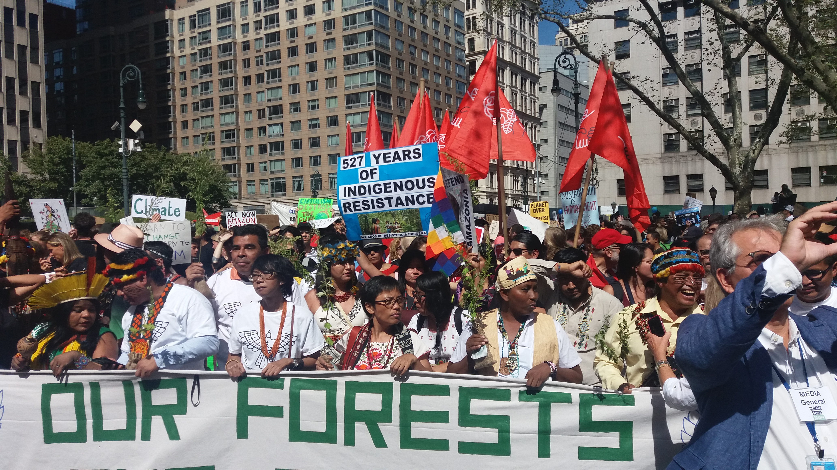

Slide 8
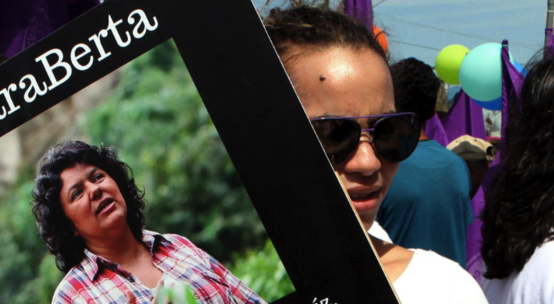
“Existential” Threats
These are existential threats to territories of life and their custodians / defenders
They run counter to customary laws and worldviews
They affect all international human rights (not just civil and political rights) – both individual and collective
Perpetrators often act with impunity – access to justice is rare

Slide 9
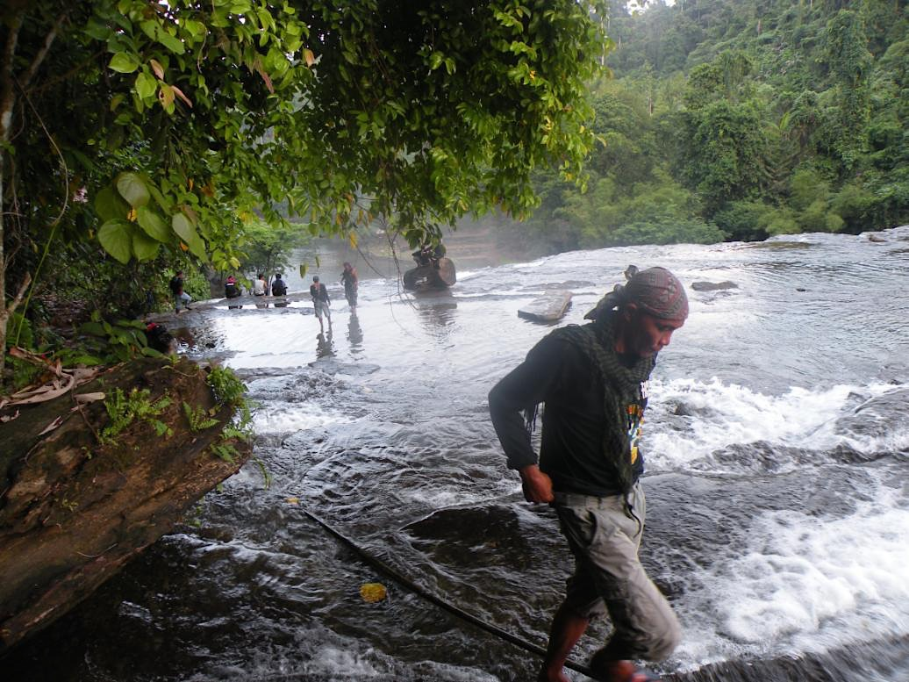
Notes:
Much of the planet’s remaining biological and cultural diversity exists within territories and areas governed, managed and conserved by indigenous peoples and local communities

Slide 10
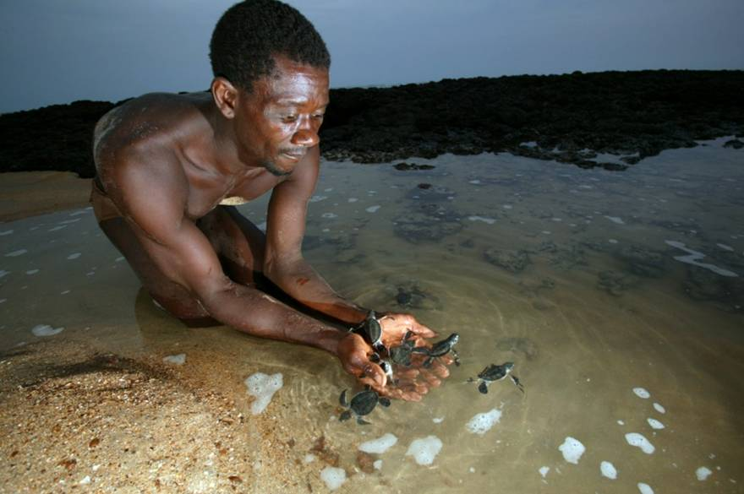
Notes:
Much of the planet’s remaining biological and cultural diversity exists within territories and areas governed, managed and conserved by indigenous peoples and local communities

Slide 11
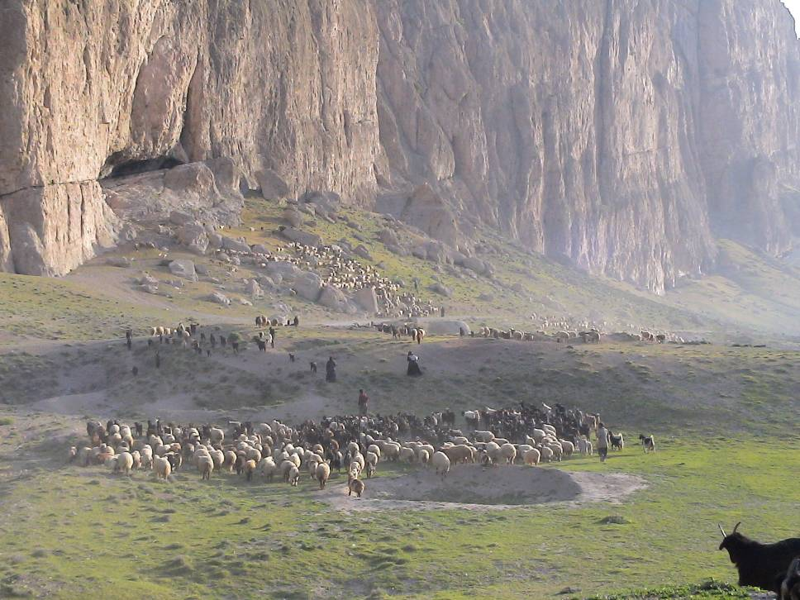
Notes:
Much of the planet’s remaining biological and cultural diversity exists within territories and areas governed, managed and conserved by indigenous peoples and local communities

Slide 12
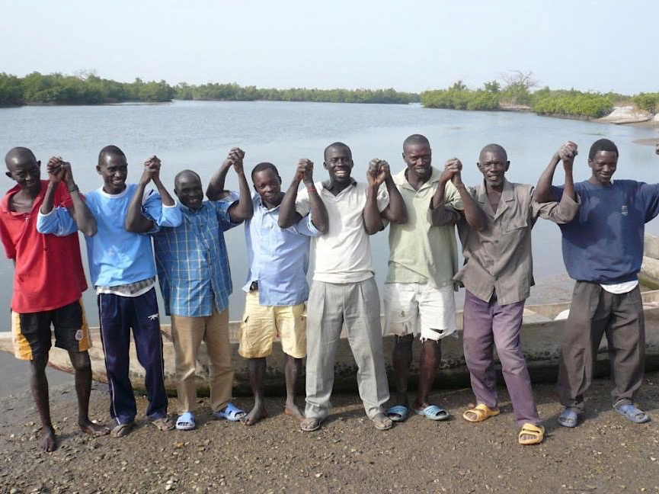
Notes:
Much of the planet’s remaining biological and cultural diversity exists within territories and areas governed, managed and conserved by indigenous peoples and local communities

Slide 13
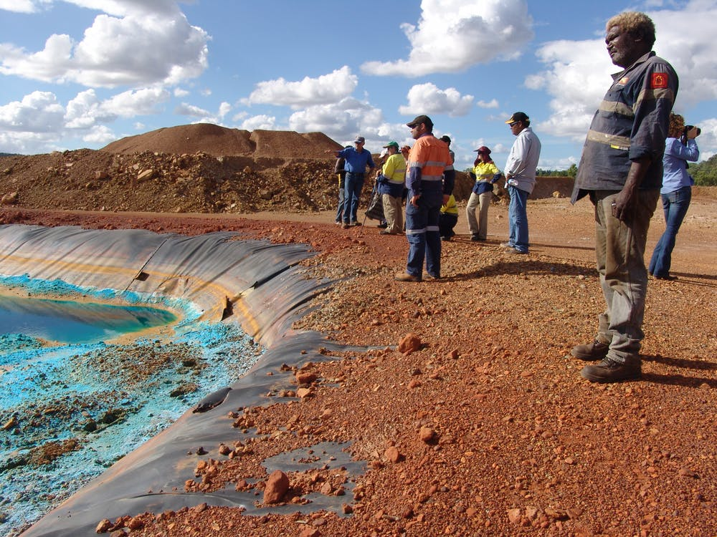
© P. Taplin
Notes:
However, these territories and areas are under increasing threat – particularly from industrial activities such as mining, infrastructure, and agribusiness

Slide 14
Notes:
However, these territories and areas are under increasing threat – particularly from industrial activities such as mining, infrastructure, and agribusiness

Slide 15
© Marc Ancrenaz
Notes:
However, these territories and areas are under increasing threat – particularly from industrial activities such as mining, infrastructure, and agribusiness

Slide 16
© Brent Millikan
Notes:
Indigenous peoples and local communities are on the frontlines of struggles to resist these threats … they are both the first and the last lines of defense to protect and defend their territories and areas.

Slide 17
© Goldman Environmental Foundation
Notes:
Indigenous peoples and local communities are on the frontlines of struggles to resist these threats … they are both the first and the last lines of defense to protect and defend their territories and areas.

Slide 18
© Bulatlat
Notes:
Indigenous peoples and local communities are on the frontlines of struggles to resist these threats … they are both the first and the last lines of defense to protect and defend their territories and areas.

Slide 19
ICCA Foundational Policy
We have a responsibility to stand up to these systemic issues and support our Members and Honorary members facing these threats
Work since 2012: responding to requests from Members to focus more on issues of threats to ICCAs, Alerts, developing “SAFE” and MoU with FoEI, engaging with various NGOs, networks and UN system, etc.
Policy aims to lay the foundation for a more explicit and coherent strategy + programme of work, bringing together all of our efforts to defend territories of life and their defenders
Intention to identify and collaborate with strategic partners (networks, alliances, etc.) for different aspects

Slide 20
The Policy Development Process
Led by Consortium’s Policy & Programme Committee
Members of the Committee:
Patricia Mupeta-Muyamwa (Chair)
Taghi Farvar
Grazia BF
José Aylwin
Aman Singh
Thomas Jalong
Felipe Gomez
Jorge Nahuel
Antonino Morabito
Secretariat support: Holly Jonas

Slide 21
2012-2014: early ‘alerts’ for situations in Philippines, Italy, Tanzania, etc. and early ideas for “SAFE”
2015-2016: proposed SAFE – meetings + regional scoping reports
2016: MoU with FoEI; Members asked for more support at Xth GA in Felipe Carrillo Puerto
2017-early 2018: developed framework for feasibility study, focusing on SE Asia – partnership w/FoEI changed
2017: included in Strategic Plan; draft position on “ICCAs as ‘No Go’ areas” discussed at Xith GA in Geneva
Notes:
March 2016 summary document: proposed main objective of SAFE = “To protect and promote the rights of the defenders of the commons and ICCAs who are at risk and/or experience a spectrum of human rights violations”
Proposed specific objectives:
Reduce risks faced by defenders and prevent violations of human rights
Offer rapid interventions in emergency situations
Support long-term actions to secure justice
Offer ‘solidarity compensation’ to defenders and/or their families who have suffered violations but have little chance to secure justice
Nov 2016: MoU with FoEI included agreement to:
Carry out a feasibility study on how SAFE could potentially operate in practice as a collaborative initiative between them
Collaborate in Asia-Pacific on concrete “SAFE initiatives” financed as part of FoEI’s EU-funded programme on environmental and human rights defenders in Asia-Pacific (agreed to start with South East Asia)
First iteration of policy: focus on ICCAs self-declared as “no-go” areas for destructive industries
Feasibility study indicative methodology:
Desktop review of recent literature and existing initiatives
Case studies to test SAFE in practice
Assessment of internal organisational considerations

Slide 22
2017-2018: broadening partnerships (Front Line Defenders, Defending the Defenders Coalition, UN Special Rapporteurs, etc.)
June-Nov 2018: second iteration of draft policy discussed at EGA in Montreal; discussions in Regional Assemblies
Nov 2018: draft policy (third iteration) tabled for adoption by XIIIth GA in Bishoftu
Next steps: further develop Action Plan + partnerships to operationalize it
Notes:
Decided to focus more on developing broader partnerships + due diligence of existing initiatives on defenders (e.g. no assessments of their effectiveness)
Second iteration:
Framed more clearly as a policy with broader scope + ‘external strategy’ with different approaches to achieve it
More clearly distinguished between position on “no-go” areas and position on “defenders”
Explicit focus on territories of life – more holistic collective dimensions and preventative measures, individual defenders is part and parcel with that
Prelim draft Action Plan
EGA: if we start with defending ICCAs, we will provide protection prior to an acute need to defend a particular defender; this is our comparative advantage vs. other organisations
Third iteration:

Slide 23
Main Parts of the Policy
Context
ICCAs at the nexus of global trends in biodiversity loss and threats to environmental human rights defenders
International legal and policy basis for this policy
Institutional policy for this basis (mission, Strategic Plan+)
A policy for the ICCA Consortium
Preamble (setting the context)
Five operational provisions
Operationalising the policy
Action plan to be reflected in yearly Consortium work plans
Voluntary theme / working group
Annexes
Annex I: Explanation of process to date and acknowledgements
Annex II: International legal and policy context (in brief)
Annex III: Overview of proposed action plan

Slide 24
Operational Provisions
Actively defend ICCAs—territories of life from harm, particularly from externally driven natural-resource intensive activities, in full concert and solidarity with their custodian indigenous peoples and local communities;

Slide 25
Operational Provisions
Actively support and defend the custodians and defenders of territories of life and stand in solidarity with them as they assert and secure their rights and responsibilities to govern, manage and conserve their territories and areas, including those who wish to independently self-declare their territories and areas as “no go” areas for certain harmful activities and/or in relevant registries and databases;

Slide 26
Operational Provisions
Enhance the capacities of its Members to recognise and stand up to threats and harms to territories of life and their defenders, including by facilitating access to practical mechanisms and tools to secure their rights, continue their work without interference and harm, monitor compliance, and seek redress and justice in the case of violations;

Slide 27
Operational Provisions
Highlight and demonstrate how ICCAs—territories of life embody sustainable self-determination and livelihoods, including by providing alternatives to the mainstream economic systems that threaten and harm territories of life and their defenders with impunity, and promote worldviews and systems that support territories of life in their entirety; and

Slide 28
Operational Provisions
Advance global, national and local systems of rights and responsibilities and foster enabling policy and legal environments in support of territories of life and their defenders, including through multiple complementary forms of legal and non-legal recognition and support.”

Slide 29
Overview of Proposed Action Plan
Securing and monitoring compliance with existing rights in specific situations of threats to ICCAs—territories of life and their defenders:
Preventing the occurrence of harms and violations
Protecting and defending territories of life and their defenders at risk (e.g., by working on specific Alerts cases and joint campaigns…)
Monitoring and reporting on situations of threats and harms (e.g., databases and registries…)
Securing redress for harms and violations and remembering those we have lost

Slide 30
Overview of Proposed Action Plan
Advancing global systems of rights, responsibilities and mechanisms to support territories of life and their defenders at risk:
Promoting reform and advancement of legal and institutional frameworks
Influencing broader narratives, supporting research and communications and shining a spotlight on territories of life and their defenders, the threats they face and the viable alternatives they embody for sustainable self-determination

Slide 31
Overview of Proposed Action Plan
Building the ICCA Consortium’s institutional basis and capacities to support territories of life and their defenders at risk:
Developing internal policies and procedures (e.g. risk assessment, digital security…)
Building internal capacities and resources and partnerships (e.g. legal support, mental health…)

Slide 32
Vision
We contribute to averting the ultimate damage of the 6th extinction event as a result of ICCA Consortium Members having been in a stronger position to prevent the occurrence of harms and violations to people and planet, defending territories of life and their defenders at risk and securing redress for harms and violations.

Slide 33
Looking ahead
Survey
Defenders Fund
Proactive support
Regional organising of Defenders work e.g. https://envirodefenders.africa/
Part of global networks and coalitions e.g. DD Coalition
Join the committee
Attend the Defenders session tomorrow

Slide 34
